Slide 1



AI,ML,DS Salary Analysis
View in Power BI
Last data refresh:
30/04/2025 14:28:24 UTC
Downloaded at:
30/04/2025 14:30:27 UTC

Slide 2
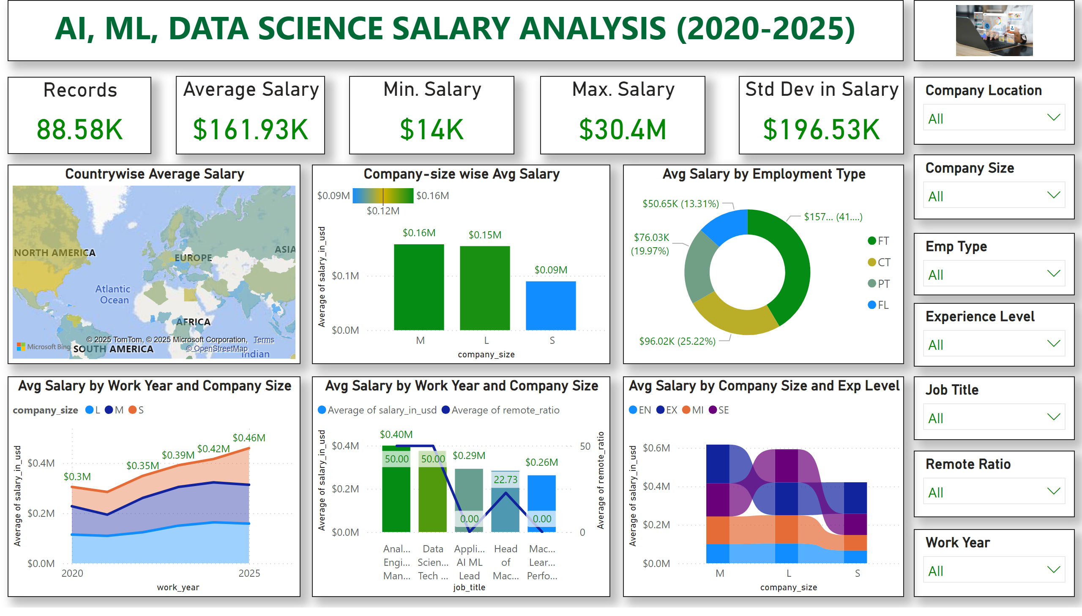
Page 1
Notes:
textbox
No alt text provided
image
No alt text provided
Records
No alt text provided
Average Salary
No alt text provided
Min. Salary
No alt text provided
Max. Salary
No alt text provided
Std Dev in Salary
No alt text provided
slicer
No alt text provided
slicer
No alt text provided
slicer
No alt text provided
slicer
No alt text provided
slicer
No alt text provided
slicer
No alt text provided
slicer
No alt text provided
Countrywise Average Salary
No alt text provided
Company-size wise Avg Salary
No alt text provided
Avg Salary by Employment Type
No alt text provided
Avg Salary by Work Year and Company Size
No alt text provided
Avg Salary by Work Year and Company Size
No alt text provided
Avg Salary by Company Size and Exp Level
No alt text provided

